Slide 1
Statistical Analysis of Genetic Association Studies

Slide 2
Session 1: Introduction

Slide 3
Genetic association studies
“Common disease, common variant hypothesis”: complex traits will be determined by several common variants each with a small impact on outcome risk
Outcome can be disease or other phenotypes e.g. measure of treatment effect (pharmacogenetics)
Basic principles:
Ascertain sample of cases and controls (binary trait) or random sample (quantitative trait) from population
Genotype all individuals in sample across genetic loci of interest
Compare genotype frequencies between cases and controls (binary trait), or compare mean trait values between genotype groups (quantitative trait)
With sufficient sample size, powerful approach to identify genetic loci associated with complex traits

Slide 4
Types of studies
Candidate genes study
Genotyped at loci across limited number of specifically chosen genes
Genome-wide association study (‘GWAS’)
Genotyped at 100s of 1000s of loci across entire human genome
Try to capture substantial amount
of ‘common’ variation
Analyses of association same for both. GWAS require additional quality control procedures
Workshop will focus on GWAS

Slide 5
SNPs
Single nucleotide polymorphism (“SNP”) = variation (between individuals) in DNA sequence at a single nucleotide
DNA sequence = string of nucleotides:
ADENINE (A) CYTOSINE (C)
THYMINE (T) GUANINE (G)
....ACGGTTAGGCTAATCCCGGTT....
Individuals identical at most loci
Variation in type of nucleotide
e.g. ACGGTTA -> ATGGTTA
Possible nucleotides at a locus=‘alleles’
Commonest allele in population = ‘wild-type’ allele
Rarest allele in population=‘mutant-type’ allele

Slide 6

Wild-Type and Mutant-Type
C
C
C
C
C
T
C
C
C
C
T
C
C
C
C
T
C
C
C
T
C
C
C
C
C
T
T
C
C
T
C
C

Slide 7

Genotypes
DNA sequence arranged in chromosomes
Chromosomes exist in pairs
At any location along DNA sequence, pair of alleles, one on each chromosome
At location of SNP, pair of alleles referred to as the individual’s genotype at SNP
e.g. First chromosome: ACGGTTA
Second chromosome: ATGGTTA
Genotype at SNP=‘CT’ genotype
One allele from mother; one allele from father

Slide 8
Categorising patients according to genotype at SNP
Because 2 possible alleles (wild-type/mutant-type), 3 possible genotypes:
Wild-type homozygote (2 x wild-type alleles e.g. CC)
Heterozygote (1 x wild-type; 1 x mutant-type e.g. CT)
Mutant-type homozygote (2 x mutant-type e.g. TT)

Slide 9
Analysing association with outcomes
For analysis, think of SNP as categorical covariate with 3 categories:
Wild-type homozygote (“WT”);
Heterozygote(“HT”);
Mutant-type homozygote (“MT”)
Compare outcome (e.g. mean blood pressure) across the three categories

Slide 10
Session 2: Linkage disequilibrium

Slide 11
Common variation in the genome
International HapMap project genotyped >3million SNPs in samples from various ancestry groups
Impractical to genotype all SNPs in genes of interest
Fortunately, common variation arranged in blocks of highly correlated SNPs (said to be in strong ‘Linkage Disequilibrium’)
Blocks separated by ‘recombination hotspots’ (areas of DNA sequence which frequently break and rejoin during reproduction, creating new DNA sequence)

Slide 12
Illustration of highly correlated blocks
BLOCK 1 | HOTSPOT | BLOCK 2 | HOTSPOT | BLOCK 3
SNPs in strong LD |  | SNPs in strong LD |  | SNPs in strong LD
Low diversity of haplotypes |  | Low diversity of haplotypes |  | Low diversity of haplotypes
SNPs in same block highly correlated with each other
Pair of SNPs in adjacent blocks uncorrelated due to high levels of recombination at flanking hotspot
Strong LD between SNPs in same block means that we observe fewer SNP combinations (‘haplotypes’) than expected by chance
Much of common variation accounted for by a small number of common haplotypes.

Slide 13
What is linkage disequilibrium (LD) ?
Where the allele at one SNP is not independent of the allele held at another SNP e.g.
ACGGTTAGGCT
ATGGTTGGGCT
Likely to be higher the closer SNPs are to each other, but LD can occur between SNPs far apart, even on different chromosomes (i.e. where large separation between hotspots)

Slide 14
Impact of LD on analyses
Can choose one representative SNP to genotype from group in high LD – ‘tagging SNP’
Choose tagging SNPs at design stage
Reduces the number of SNPs genotyped and analysed, leading to:
Reduced genotyping costs
Less SNPs to adjust for multiple testing (more later…)
When interpreting statistically significant associations, bear in mind that SNP may not be causal SNP itself, but one in LD with it

Slide 15
Measuring LD
If:
p(A) = observed probability of allele 'A' for SNP 1
p(a) = observed probability of allele 'a' for SNP 1
p(B) = observed probability of allele 'B' for SNP 2
p(b) = observed probability of allele 'b' for SNP 2
p(AB) = observed probability of the allele pair ‘AB’
two different measures of LD are:
D = p(AB) - p(A)*p(B)
r = -D / (sqrt( p(A) * p(a) * p(B) * p(b) ) )
‘D’ = raw difference in frequency between observed and expected number of AB pairs
R = correlation coefficient between the two SNPs

Slide 16
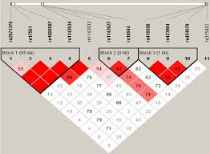
Example of LD blocks (“Haploview”)

Slide 17
Session 3: Checking Genotype Data

Slide 18
Genotype Quality Control
Errors in genotyping can introduce systematic bias:
increased false positive rate
decreased power
Several checks must be undertaken on genotype data as part of quality control
Can be separated into ‘per sample’ and ‘per SNP’ checks
Filter out samples/SNPs that fail checks
Generally advisable to check and filter samples first then SNPs (although there are many different schools of thought)

Slide 19
a) Per sample checks

Slide 20
Missing data
If genotype difficult to ascertain, no genotype call will be made
Genotype marked as missing
‘High’ proportion of missing data per sample ~ problem with sample
Important to check for extent of missingness per sample

Slide 21
Checks for missing data
Graphical: histogram
highlights problematic samples
Cutoffs:
Exclude samples above cutoffs (either pre-specified or distribution-based) e.g.2%

Slide 22
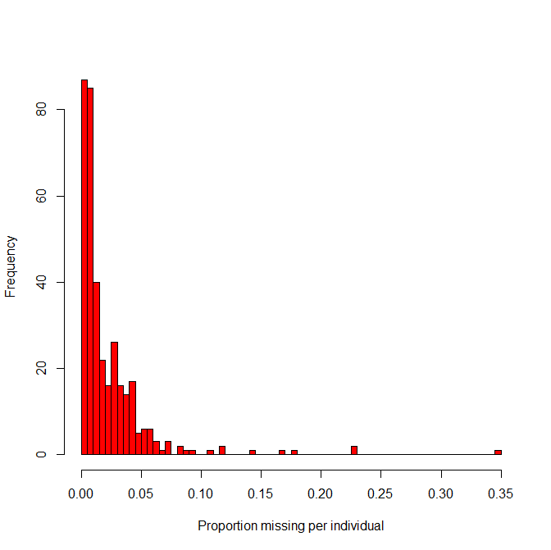
Missing data: example
360 patients genotyped across 187 SNPs
Histogram of rate missing per individual:
Sensible cutoffs may be:
5% - 32 individuals (9%) excluded
7% - 16 indiviuals (4%) excluded
10% - 9 individuals (3%) excluded
Cutoffs will also be dependent on chip density (sparser chip, higher cutoff)
Notes:
Cdf instead ?

Slide 23
Gender checks (GWAS only)
Can infer gender from genotype rates of SNPs on X-chromosome
Rates of heterozygosity differs with gender
Should be no heterozygosity in males (but expect some genotyping error)
Look at rates of heterozygosity of X-chromosome and compare with reported gender
If high proportion (>50%) mis-match to gender reported in phenotype data, suggests problem in aligning genotype data to clinical data
If lower proportion, double-check clinical data and exclude if problem cannot be resolved - may indicate sample-swap
Notes:
F statistic ???

Slide 24
Gender checks – example
Each individual plotted twice according to reported gender
Upper plot: females red; males grey
Lower plot: males blue; females grey

Slide 25
Duplicate/related samples (GWAS only)
Statistical analyses assume independence of samples
Assumption compromised if two samples are:
i) duplicated; or
ii) closely related
Possible to assess pairwise degree of relatedness from identity-by-descent (‘IBD’) coefficient
Plot histogram of IBD – provided low frequency of 3rd degree relatives (IBD=0.125) use 0.1875 (exactly in-between 2nd and 3rd degree relatives) as cutoff
Exclude one (with least missing data) from each pair with IBD>0.1875

Slide 26
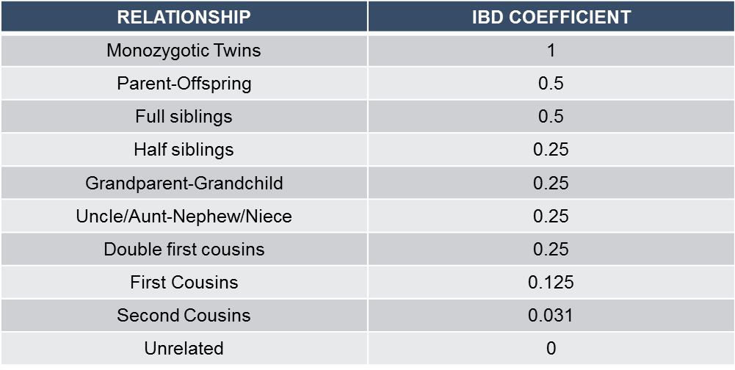
Duplicate/related samples
IBD for relatives as follows:

Slide 27
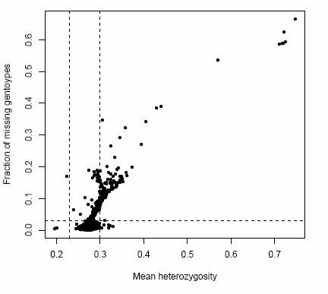
Heterozygosity (GWAS only)
Samples with extreme heterozygosity rates can suggest mixed samples/sample contamination
Plot mean heterozygosity vs proportion missing genotypes to identify outliers

Slide 28
b) Per SNP checks

Slide 29
Missing data
If genotype difficult to ascertain, no genotype call will be made
Genotype marked as missing
‘High’ proportion of missing data per SNP ~ problem with SNP

Slide 30
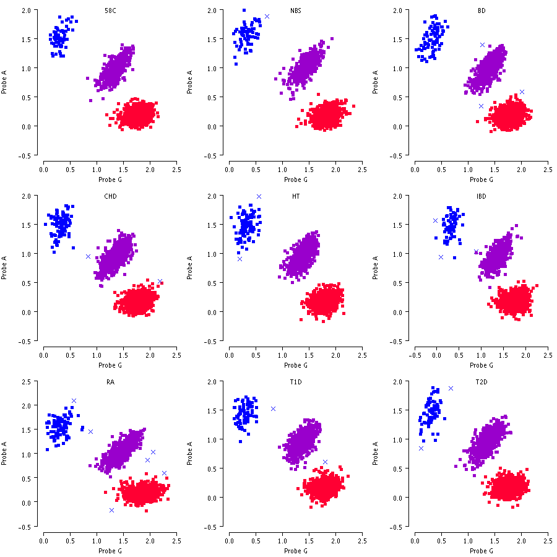
Genotype calling – ‘good SNPs’

Slide 31
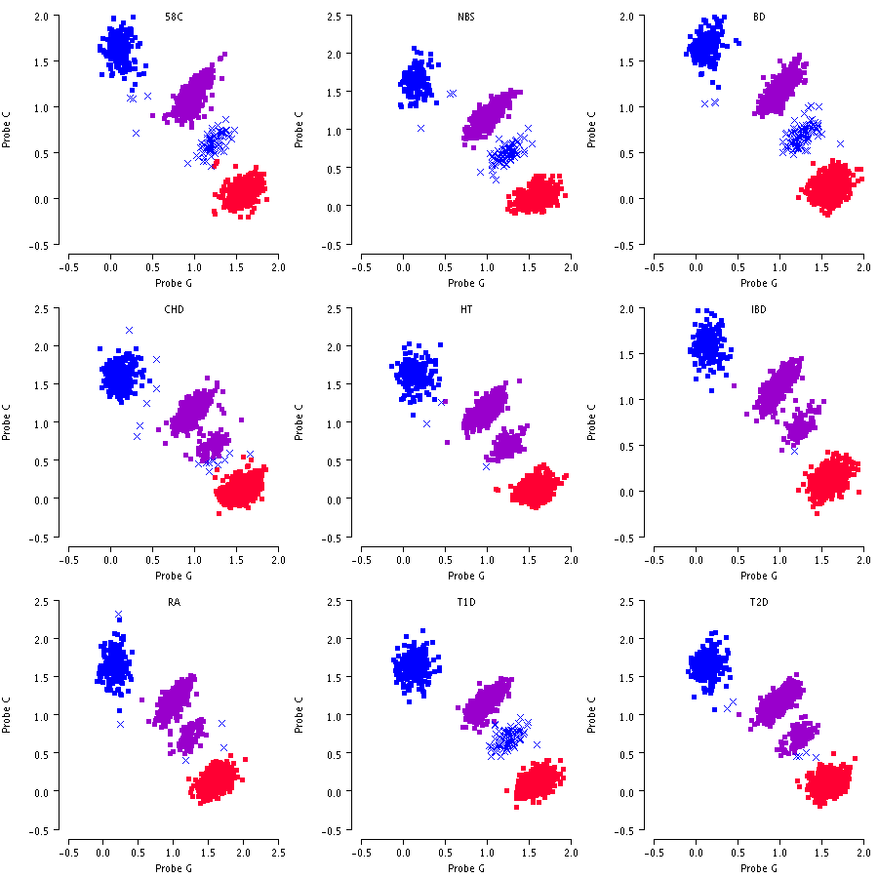
Genotype calling – ‘bad SNPs’

Slide 32
Checks for missing data
Important to check for extent of missingness per SNP
Graphical: histogram
highlights problematic SNPs
Cutoffs:
Exclude SNPs above cutoffs (either pre-specified or distribution-based) e.g. 5%
Notes:
Add bit from gwas qc

Slide 33
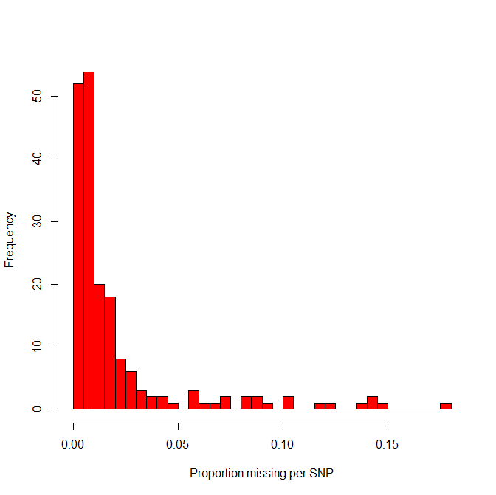
Missing data: example (cont…)
344 patients genotyped across 187 SNPs
Histogram of rate missing per SNP:
Sensible cutoffs may be:
5% - 21 SNPs (11%) excluded
10% - 9 SNPs (5%) excluded

Slide 34
Differential call rates in cases/ controls
Also important to compare rate of missingness between cases and controls
If differences extreme, can lead to false positives:
Individuals called as missing
Leads to lower proportion heterozygotes in cases
Notes:
More explanation/two histograms ?

Slide 35
Minor allele frequency
‘MAF’
The frequency of the mutant-type allele
Candidate gene studies/GWAS aimed at investigating association with relatively common SNPs
Lack of power to detect association with rarer variants (<1%, or even 5% with smaller sample sizes)
Rarer variants require a different, specialist approach
Choose appropriate cut-off: 5% or 1%
Exclude SNPs with MAF below this cutoff
Notes:
Example of rarer variant method ?

Slide 36
Hardy-Weinberg Equilibrium
If study population is randomly-mating population, genotypes at each SNP should be in Hardy-Weinberg Equilibrium (‘HWE’)
If:
p=frequency of wild-type allele
q=frequency of mutant-type allele
Then:
Frequency WT genotype=p²
Frequency HT genotype=2pq
Frequency MT genotype=q²

Slide 37
Deviations from HWE
Deviation can:
indicate non-random mating/inbreeding
indicate problem with genotyping procedure e.g. miss-calling MT as WT
indicate that population substructure is present (more later...)
Important to test for HWE at each SNP prior to analysis of association
Test in cases and controls separately
Test using chi-square test, or Fisher’s exact test if one genotype particularly rare
Significance threshold: p<0.0001

Slide 38
Testing for HWE: Example
SNP rs9923231 genotyped in 470 cases
Genotype frequencies:
STEP 1: Calculate allele frequencies:
Wild-type: 2 for each WT Homozygote (2*160) + 1 for each Heterozygote (240) = 560
Mutant-type: 2 for each MT Homozygote (2*70) + 1 for each Heterozygote (240)=380
Genotype | n | Frequency
WT Homozygote | 160 | 0.34
Heterozygote | 240 | 0.51
MT Homozygote | 70 | 0.15
TOTAL GENOTYPES | 470 | 1
Wild-type | 560
Mutant-type | 380
TOTAL ALLELES | 940

Slide 39
Testing for HWE: Example (cont…)
STEP 2: Calculate expected genotype frequencies
p(WT frequency) = 560/940 = 0.596
q(MT frequency) = 380/940 = 0.404
Expected frequencies:
WT homozygotes = p² = 0.596² = 0.355
Heterozygotes = 2pq = 2 * 0.596 * 0.404 = 0.482
MT homozygotes = q² = 0.404² = 0.163
STEP 3: Compare expected genotype frequencies to observed
Genotype | Observed | Expected
WT Homozygote | 160 | 0.355*470=167
Heterozygote | 240 | 0.482*470=226
MT Homozygote | 70 | 0.163*470=77

Slide 40

Testing for HWE: Example (cont…)
STEP 4: Undertake chi-squared test to compare frequencies
𝞆² = $\sum{\frac{\left(o−e\right)2}{e}}$ =0.29+0.87+0.64=1.8
Compare to 𝞆² distribution with 1 degree of freedom: p-value=0.18
Genotype | Observed | Expected | o-e | (o-e)²/e
WT Homozygote | 160 | 167 | -7 | 0.29
Heterozygote | 240 | 226 | 14 | 0.87
MT Homozygote | 70 | 77 | -7 | 0.64
Notes:
Conclusions…

Slide 41
Session 4: Population stratification

Slide 42
What is population stratification ?
Where study population includes people from variable ancestry (i.e. different sub-populations), and all of following true:
Minor allele frequency differs between the sub-populations; and
Outcome prevalence differs between the sub-populations; and
Outcome is independent of the SNP of interest.

Slide 43
Illustration of population stratification
2 sub-populations (green population and blue population)
Hypothesis of interest: having minor allele at SNP A increases risk of allergic rash when taking drug
Null hypothesis is true (i.e. having minor allele does not increase risk), but:
outcome more common in green population; and
minor allele more common in green population
So...

Slide 44
Illustration of population stratification
80% prevalence
40% prevalence
7% WT/93% MT
67% WT/33%MT
 | WT | MT
Cases
Controls
(n=5; 28%)
(n=13; 72%)
(n=6; 50%)
(n=6; 50%)
p-value chi-squared test: 0.01 , significant association
= 5 individuals

Slide 45
What if we stratify by sub-population ?
 | WT | MT
Cases
Controls
(n=1; 8%)
(n=11; 92%)
(n=0; 0%)
(n=3; 100%)
p-value chi-squared test: 0.56, not significant
 | WT | MT
Cases
Controls
(n=4; 67%)
(n=2; 33%)
(n=6; 67%)
(n=3; 33%)
p-value chi-squared test: 0.80, not significant

Slide 46
Dealing with population stratification
If there are obviously >1 distinct sub-populations e.g. >1 different ethnic groups
stratify analysis
match cases and controls by ethnicity
exclude some (if sub-population(s) small)
include covariate representing ethnicity in regression model
Sometimes stratification is more subtle: ‘cryptic population substructure’ e.g. apparent association between SNPs and type II diabetes in Pima Indians:
type II diabetes more prevalent in Caucasians
association false positive due to population substructure: cases had greater proportion Caucasian ancestry and allelic frequency varied between the populations

Slide 47
Dealing with cryptic population substructure
Many methods proposed (e.g. genomic control, structured association, variance components)
We focus on just one method – principle components analysis (PCA)
PCA used to infer continuous axes of genetic variation (eigenvectors)
Reduces data to small number of dimensions, describing as much variability between individuals as possible
We can make use of PCA in GWA studies to:
identify “population outliers” using genotype data available from the HapMap project
generate axes of genetic variation to account for substructure within the study population, and adjust for it in analysis

Slide 48
Using PCA analysis to identify population outliers
The international HapMap project provides high-density genotype data for three reference populations:
30 CEPH trios from Utah with Northern European ancestry (CEU)
30 Yoruba trios from Ibadan, Nigeria (YRI)
45 unrelated Japanese individuals from Tokyo (JPT) and 45 unrelated Han Chinese individuals from Beijing (CHB)
HapMap samples can be used to define two axes of genetic variation (the ‘principle components’) that broadly distinguish populations of European, African and Asian ancestry
Perform PCA with genotype data from GWA study combined with that from reference HapMap samples at same SNPs
Exclude population outliers from association analysis

Slide 49
Example: UK Wellcome Trust Case-Control Data
Afro-Caribbean samples
South Asian samples

Slide 50
Using PCA analysis to adjust for population substructure
Apply same PCA techniques to genotype data from GWAS study without using HapMap samples as reference
Obtain axes of genetic variation (“principle components”)
Are axes of genetic variation associated with disease phenotype (e.g. if disease prevalence varies with substructure) ?
If associated, could inflate genotype-phenotype association statistics, creating false positives
Use principle components as covariates within logistic regression modelling framework to adjust for underlying population substructure

Slide 51
Session 5: Univariate analyses of association

Slide 52
Types of outcome measures
Quantitative
biomarker value
therapeutic dose of a drug
Binary
presence of a disease
achieving therapeutic response
Time to an event
Time to therapeutic dose
Time to achieving 12 month remission from epilepsy

Slide 53
Binary outcomes
Use chi-squared test to test for association between genotype and outcome
If expected count of any cell less than 5, Fisher’s exact test instead
 | WT | Het | MT
Case (expected count) | 10 | 30 | 12
Control (expected count) | 200 | 100 | 20
 | WT | Het | MT
Case (expected count) | 25 | 15 | 2
Control (expected count) | 150 | 40 | 6
All cells>5 so use Chi-square test
Cell count <5 so use Fisher’s exact test

Slide 54
Testing association: example
Case-control study to test whether SNP rs4363657
in SLCO1B1 gene associated with statin-induced myopathy
77 cases with statin-induced myopathy and 150 controls with history of statin use but no myopathy recruited from GP Research Database
SNP rs4363657 genotyped in all cases and controls
1 case patient failed genotype QC
Contingency table created as follows:
Chi-squared test statistic: χ²=3.53
Compare to chi-squared distribution with 2 degrees of freedom: p-value=0.17
Conclusion: insufficient evidence to suggest association between SNP rs4363657 and statin-induced myopathy
ti
 | WT Homozygote | Heterozygote | MT Homozygote
Case | 44 | 24 | 8
Control | 101 | 42 | 7

Slide 55
Quantitative outcomes
First step, plot as histogram to check for normality of data
If approximately normal (bell-shaped, symmetrical about mean)– OK to continue
If not normal, transform e.g. log, square-root
Re-check transformed data for normality (histogram)
Test for association between each SNP in turn and outcome
ANOVA

Slide 56
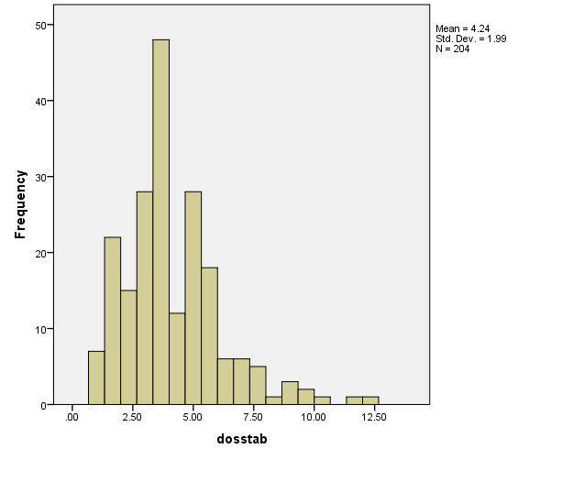
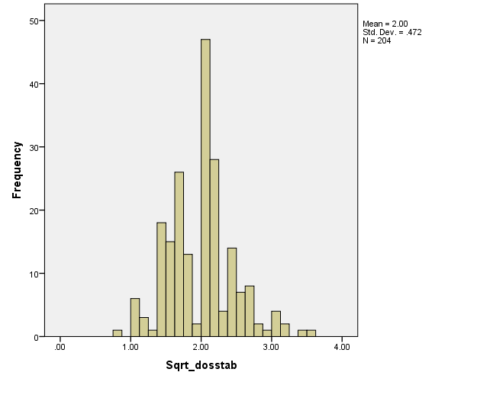
Example of testing for association: ANOVA
Prospective cohort study to test whether association between CYP2C9*3 SNP and warfarin stable dose requirements
312 patients followed up from initiation of warfarin to achievement of stable dose. Only 204 patients achieved stability during follow-up.
Genotyped at several SNPs including CYP2C9*3 (rs1057910)
Distribution of stable dose skewed so analysed using square-root transformation
Original data: skewed
Transformed data: normal

Slide 57
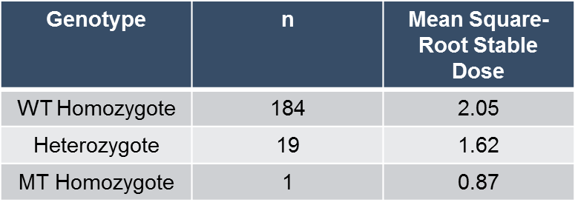
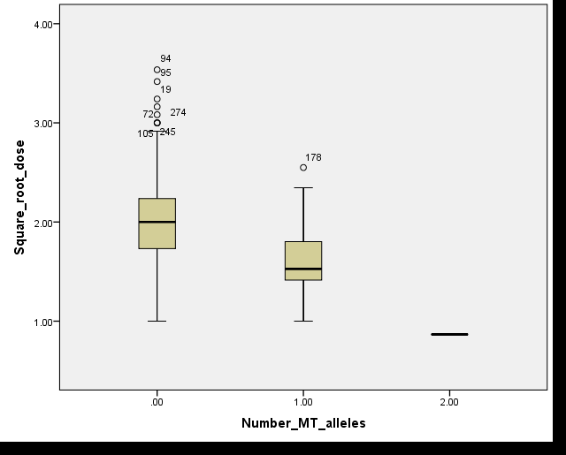
Summary per genotype group

Slide 58
ANOVA Results
 | Sum of Squares | df | Mean Square | F statistic | p-value
Between Groups | 4.51 | 2 | 2.257 | 11.152 | 0.000
Within Groups | 40.68 | 201 | 0.202
Total | 45.20 | 203
Conclusion: SNP rs1057910 significantly associated with stable dose requirements, with those with mutant allele(s) requiring less dose

Slide 59
Interpretation of results
A significant results in a test of association can mean:
Genotyped SNP is causative, directly effecting outcome. This would need to be confirmed in functional studies.
Genotyped SNP is correlated (in LD) with causative SNP, but does not directly influence outcome.
Above assumes appropriate QC procedures undertaken to minimise risk of false positives !
SNP
Outcome
True
Causal
SNP
SNP
Outcome

Slide 60
Session 6: Considering different modes of inheritance

Slide 61

Different modes of inheritance
Dominant
Only 1 copy MT allele required for effect on outcome
Effect 1 copy = effect 2 copies
Recessive
Effect only seen if 2 copies of mutant allele
Additive
Effect 1 copy exactly in-between effect of 0 copy and 2 copies
Effect 2 copies MT = 2 x effect 1 copy
WT
Het
MT
WT
Het
MT

Slide 62
Assuming modes of inheritance in analysis
In examples so far we have made no particular assumption regarding mode of inheritance
We treated each genotype group separately without making assumptions regarding relationship between them
Making different assumptions will influence our approach to analysis…

Slide 63
Analysis approach – binary outcomes
Mode of inheritance | Univariate analyses approach | Genotype coding for SNP covariate in regression model approach
Dominant | Chi-squared/Fisher’s exact test* comparing only 2 groups: (Hetero + MT Homo) vs (WT Homo) | WT Homo: 0 Hetero: 1 MT Homo: 1
Recessive | Chi-squared/Fisher’s exact test* comparing only 2 groups: (MT Homo) vs (WT Homo + Hetero) | WT Homo: 0 Hetero: 0 MT Homo: 1
Additive | Cochrane-Armitage Trend Test (assumes ordering of genotype categories: WT Homo > Hetero > MT Homo) | WT Homo: 0 Hetero: 1 MT Homo: 2
* If any expected cell count<5

Slide 64
Analysis approach – quantitative outcomes
Mode of inheritance | Univariate analyses approach | Genotype coding for SNP covariate in regression model approach
Dominant | Student’s t-test: (WT Homo) vs (Hetero + MT Homo) | WT Homo: 0 Hetero: 1 MT Homo: 1
Recessive | Student’s t-test: (MT Homo) vs (WT Homo + Hetero) | WT Homo: 0 Hetero: 0 MT Homo: 1
Additive | Linear regression with a single covariate representing SNP using genotype coding as per multiple regression approach | WT Homo: 0 Hetero: 1 MT Homo: 2

Slide 65
Which mode of inheritance should we assume ?
Often naïve about mode of inheritance
Could analyse under all different modes, but multiple testing problem
Additive assumption usually most powerful unless extreme deviation from this model
Usually take additive/no assumption approach
For significant SNPs can then test whether other modes of inheritance fits data better e.g. comparing likelihoods

Slide 66
Session 7: Multiple regression analyses

Slide 67
Adjusting for covariates
In many cases, other, non-genetic factors are associated with outcome e.g. age, gender
Some of these factors may be confounders (associated with both outcome and SNP)
Important that these factors are adjusted for appropriately in our analyses of association to reduce risk of false positives
Can adjust by using a multiple regression approach

Slide 68
Assessing association with SNP whilst adjusting for non-genetic factors
Procedure is:
Test each non-genetic factor univariately for association with outcome
Build regression model including all non-genetic factors found significant univariately (p<0.05) – the BASELINE MODEL
Build regression model identical to baseline model but also includes covariate(s)* to represent SNP – the GENETIC MODEL
Calculate -2 x difference in log-likelihood between the two models to obtain chi-squared statistic(baseline-genetic) – this is known as the likelihood ratio test
Compare chi-squared statistic to chi-squared distribution to obtain p-value (degrees of freedom = number of covariates used to represent SNP)
* Number of covariates used to represent SNP is influenced by assumption made about mode of inheritance. If no assumption, 2 covariates (1 representing Hetero; 1 representing MT Homo). If any other assumption, 1 covariate. Individuals coded for genotype according to previous slides.

Slide 69
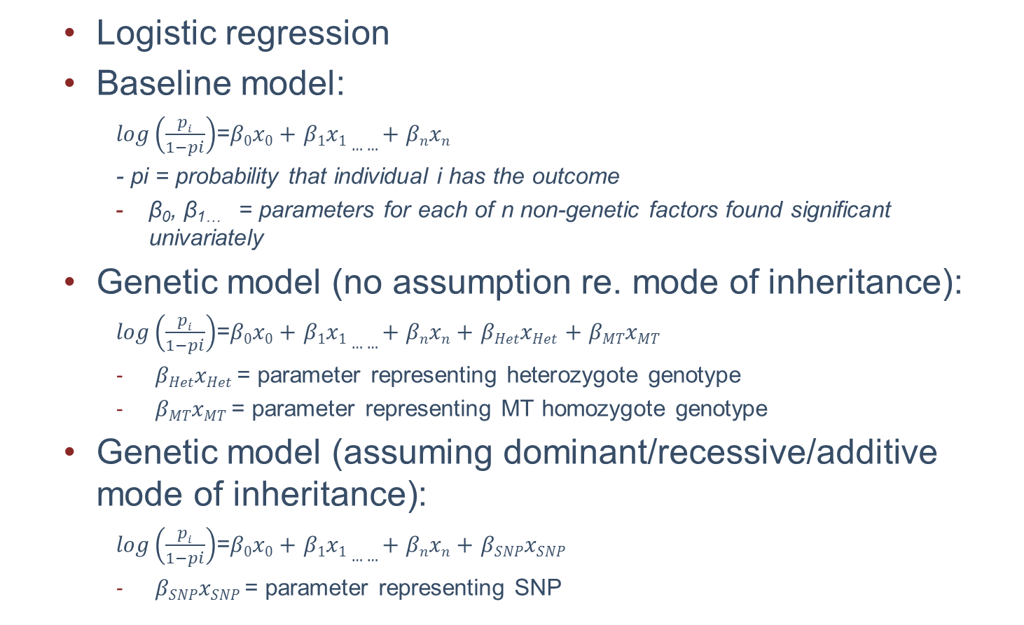
Illustration – Binary outcome
Logistic regression
Baseline model:
$log\left(\frac{pi}{1−pi}\right)$=$β0x0+$ $β1x1……+$ $βnxn$
- pi = probability that individual i has the outcome
β₀, β_{1…} = parameters for each of n non-genetic factors found significant univariately
Genetic model (no assumption re. mode of inheritance):
$log\left(\frac{pi}{1−pi}\right)$=$β0x0+$ $β1x1……+$ $βnxn+$ $βHetxHet$ $+$ $βMTxMT$
$βHetxHet$ = parameter representing heterozygote genotype
$βMTxMT$ = parameter representing MT homozygote genotype
Genetic model (assuming dominant/recessive/additive mode of inheritance):
$log\left(\frac{pi}{1−pi}\right)$=$β0x0+$ $β1x1……+$ $βnxn+$ $βSNPxSNP$
$βSNPxSNP$ = parameter representing SNP

Slide 70
Example – Quantitative outcome
Again assume prospective cohort study to test whether association between CYP2C9*3 SNP (rs1057910) and warfarin stable dose requirements
This time also collected data on gender, age and BMI, all suspected as influencing stable dose requirements
As already established, stable dose has skewed distribution so used a square-root transformation
First, tested for association between each non-genetic variable and square-root stable dose. Results as follows:
Covariate | Test of Association | P-value
Age | Linear Regression | <0.0001
Gender | T-test | 0.20
BMI | Linear Regression | <0.0001

Slide 71
Example – Quantitative outcome (cont.)
Next, fit linear regression model (baseline model) including the non-genetic covariates significant univariately (p<0.05: age; BMI) and obtain log-likelihood: -117.96
Next, fit baseline model plus covariate* to represent SNP (genetic model) and obtain log-likelihood: -100.22
We now calculate the chi-square statistic as -2 x difference in log-likelihood i.e. -2 (-117.96+100.22)=35.48
Comparing this statistic with a chi-square test with 1 degree of freedom we have: p-value<0.0001
*Here we assume an additive mode of inheritance, therefore include one covariate to represent the SNP, coded 0 (WT), 1 (Het), 2 (MT)

Slide 72
Session 8: Multiple Testing
Notes:
Morning: go through slides (9.30-11 then 11.30-1)
Afternoon: Candidate gene practical (2-3.30) then PLINK example (3.45-5)
Consider two days ? Or, omit PLINK
Need background understanding of R, or try and do all in PLINK ? – but what about QC ?
Practice on staff ?

Slide 73
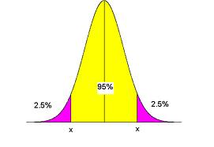
Probability of false positives
When testing null hypothesis e.g. no association between SNP and outcome, there is certain probability of rejecting null hypothesis even though it is true (i.e. concluding there is an association when in fact there is not)
This probability is known as type I error rate, and we typically set it at 5%

Slide 74
Problem with testing large number of hypotheses
When type I error rate is 5% there is 5% chance of rejecting null hypothesis when in fact it is true (false positive)
Probability of false positive increases with number of tests performed

Slide 75
Accounting for multiple testing
In candidate gene study can use correction methods to maintain the type I error rate for the study as a whole
Examples are:
Bonferroni – set type I error rate for each SNP to study-wide type I error rate divided by the total number of SNPs e.g. if 10 SNPs, type I error rate is 0.005 for each SNP
False Discovery Rate (FDR) – calculated in addition to p-values for all SNPs. Represents the expected proportion of false positives among all positive findings (rejected null hypotheses)
In GWAS, we set significance threshold to 5x10^{-8 :} this was estimated with regards to the large number of SNPs tested, but allowing for fact that not all SNPs completely independent (LD)

Slide 76
Session 9: Genotype Imputation
Notes:
Morning: go through slides (9.30-11 then 11.30-1)
Afternoon: Candidate gene practical (2-3.30) then PLINK example (3.45-5)
Consider two days ? Or, omit PLINK
Need background understanding of R, or try and do all in PLINK ? – but what about QC ?
Practice on staff ?

Slide 77
9-10.30: Session 1 and 2 10.45-12.15: Practical 1: Exploring genotype data incl. LD 1-2.30: Session 3 2.30-4.00: Practical 2: QC 4.15-5.30-Session 4 9-10.15: Practical 3: Population Stratification 10.30-12.15: Session 5,6,7,8 1-3: Practical 4: Analyses of association (pre-imputation) 3.15-4: Session 9 4-5.30: Practical 5: Imputation and analyses of association post-imputation

